Slide 1
How to build an Industry Cost Profile (ICP) for a product in Canada
Identify industry code based on the supplier’s business and product
Step 2
Identify data sources for financial and manufacturing information related to industry code
Step 3
Step 1
Use industry data to calculate ratios for DM, DL, MOH, COGS, GSA & PBT

Slide 2
Use Financial Data to Calculate Ratios for COGS, PBT, GSA & Other
Steps 1 & 2
From each firms’ Income Statement, use multiple year averages to calculate COGS, GSA & Other Expenses and PBT.
Use as many firms as you judge necessary to get an accurate representation of the industry you are modelling.
Stelco Holding*
 |  | 2019 | 2018 | 2017 | Average
 | COGS | 84.5% | 84.4% | 85.9% | 85.0%
 | GSA & Other | 8.9% | 9.7% | 16.4% | 11.7%
 | PBT | 6.6% | 5.9% | -2.3% | 3.4%
 | Total Sales | 100% | 100% | 100% | 100%
*Example firm operating in the Iron and steel manufacturing space
$$COGS \%=\frac{COGS}{Total Sales}$$
$$PBT \%=\frac{PBT}{Total Sales}$$
GSA & O. Exp. % = Total sales (100%) – COGS % – PBT %

Slide 3
Use Financial Data to Calculate Ratios for COGS, PBT, GSA & Other
Steps 1 & 2
Average the ratios of the selected firms to create your industry ratios.
Selected firms in Iron and steel manufacturing space*
 |  | Firm 1 | Firm 2 | … | Firm 7 | Average
 | COGS | 85.0% | 81% | … | 83% | 82.2%
 | GSA & Other | 11.7% | 10% | … | 9% | 9.4%
 | PBT | 3.4% | 9% | … | 8% | 8.4%
 | Total Sales | 100% | 100% | … | 100% | 100%
*Example data for illustration purposes only

Slide 4
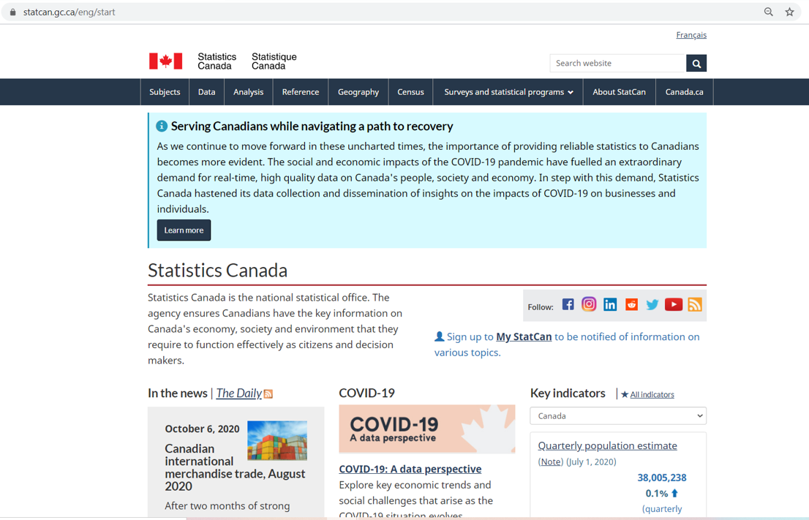
Identify Industry & obtain Financial and Manufacturing Information Related to Industry
Steps 1 & 2
Go to:
Click on “Subjects”
https://www.statcan.gc.ca/eng/start

Slide 5
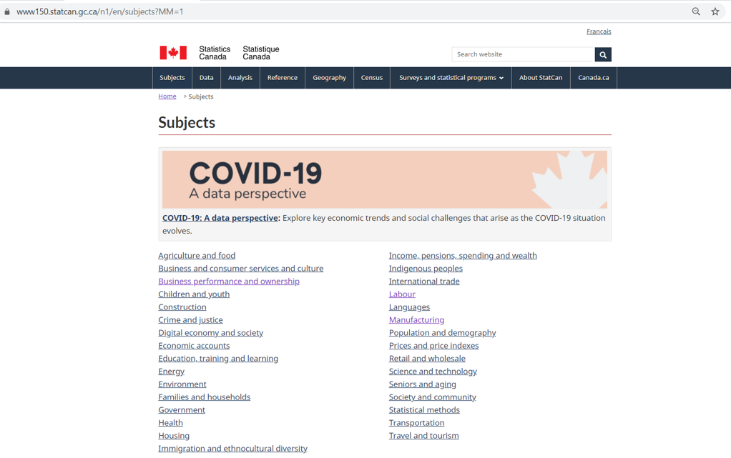
Identify Industry & obtain Financial and Manufacturing Information Related to Industry
Steps 1 & 2
Click on “Business performance and ownership”

Slide 6
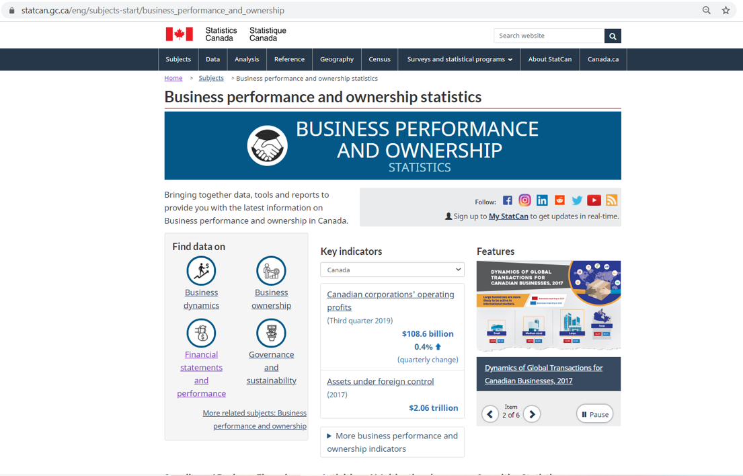
Identify Industry & obtain Financial and Manufacturing Information Related to Industry
Steps 1 & 2
Click on “Financial statements and performance”

Slide 7
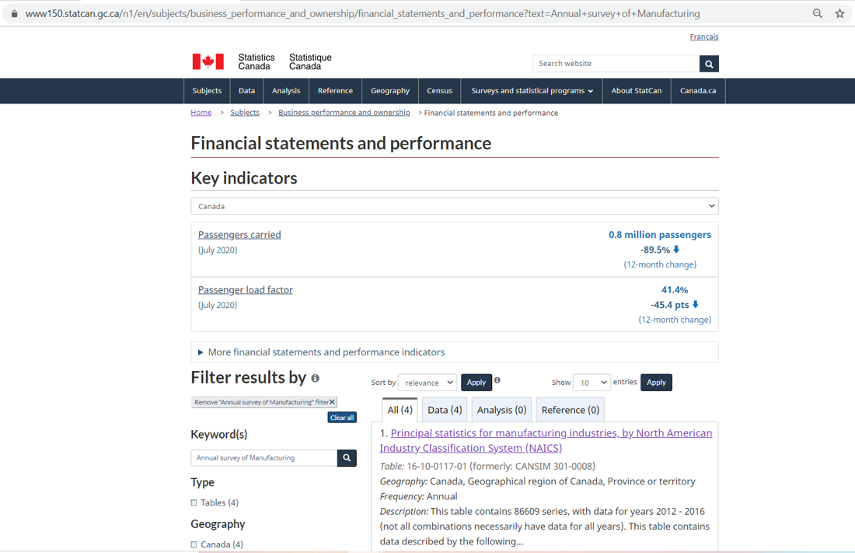
Identify Industry & obtain Financial and Manufacturing Information Related to Industry
Steps 1 & 2
Search “Annual Survey of Manufacturing”
Click on “Principal statistics for manufacturing industries, by NAICS”

Slide 8
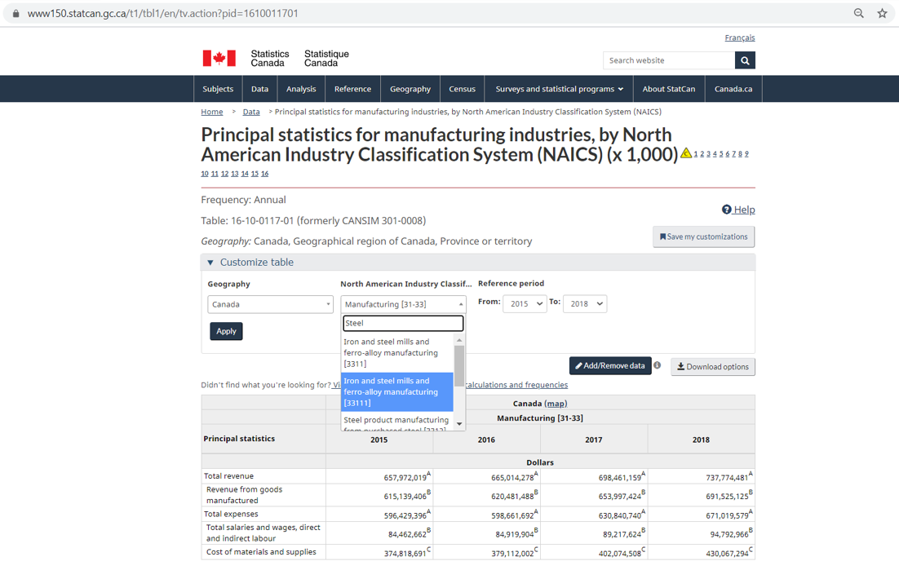
Identify Industry & obtain Financial and Manufacturing Information Related to Industry
Steps 1 & 2
Search “Steel”
Click on “Iron and steel mills and ferro-alloy manufacturing”
Click on “Apply”

Slide 9
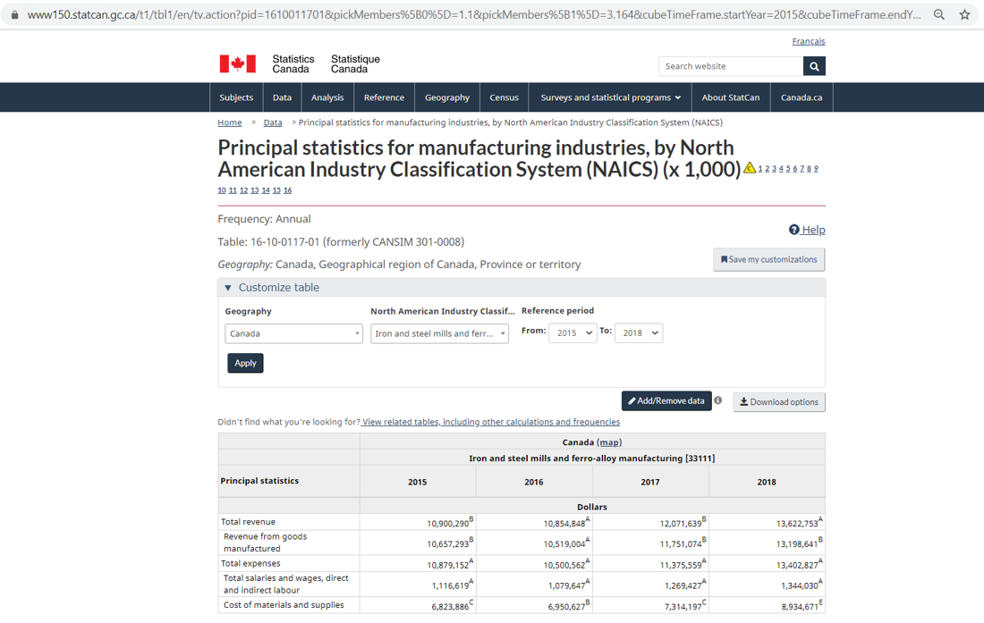
Identify Industry & obtain Financial and Manufacturing Information Related to Industry
Steps 1 & 2
Record the data highlighted:

Slide 10
Use Financial and Manufacturing Information to Calculate Ratios
Step 3
1. Calculate the Direct Material (DM) ratio as: Cost of Material and Supplies ÷ Total Revenue
2. Calculate Direct Labor (DL) as follows:
(Total salaries and wages, direct and indirect labor* 80%) ÷ Total Revenue
1.
 | Cost of Material and Supplies | 8,934,671
 | Total Revenue | 13,622,753
 | Direct Material (DM) | 65.6%
 | Total salaries and wages, direct and indirect labor | 1,344,030
 | Attributable to Direct Labor | x 80%
 | Total Revenue | 13,622,753
 | Direct Labor (DL) | 7.9%
2.

Slide 11
Use Financial and Manufacturing Information to Calculate Ratios
Step 3
3. Calculate MOH as follows:
COGS-(DM+DL)
 | Cost of Goods Sold | 82.2%
 | Direct Material | - (65.6%
 | Direct Labor | + 7.9%)
 | MOH | 8.7%
3.
Notes:
Korea-
Basic Metal Manufacturing
COGS 116,108,609
DM 79,607,506
DM/COGS=68%

Slide 12
Present all your calculated ratios in the cost breakdown format
Industry cost profile for “Iron and steel mills and ferro-alloy manufacturing in Canada”
 | Direct Material (DM) | 65.6%
 | Direct Labor (DL) | 7.9%
 | Manufacturing Overhead (MOH) | 8.7%
 | Cost of Goods Sold (COGS) | 82.2%
 | SGA & Other Expenses | 9.4%
 | Profit Before Tax (PBT) | 8.4%
 | Total Sales | 100.0%
Ratios calculated from ”Statistics Canada Online databank and Company Financials”

